Slide 1
Department of Computer Science & Engineering Mini Project Presentation (KCS-554) On “ Arduino Based Soil Detection System “
Student
Teacher

Slide 2
INTRODUCTION
This device is made for measuring air temperature, air humidity and soil moisture and can be useful in gathering data for a plant environment.
Soil moisture sensors measure the volumetric water content in soil Soil moisture sensors typically refer to sensors that estimate volumetric water content.
Temperature and Humidity sensor (DHT11) measures air temperature and air humidity which is present in the environment .

Slide 3
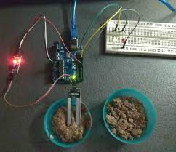
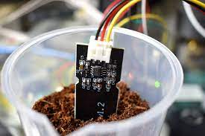
AIM
TO DETECT SOIL MOISTURE, AIR TEMPERATUE AND HUMIDITY SENSING THROUGH ARDUINO UNO .

Slide 4
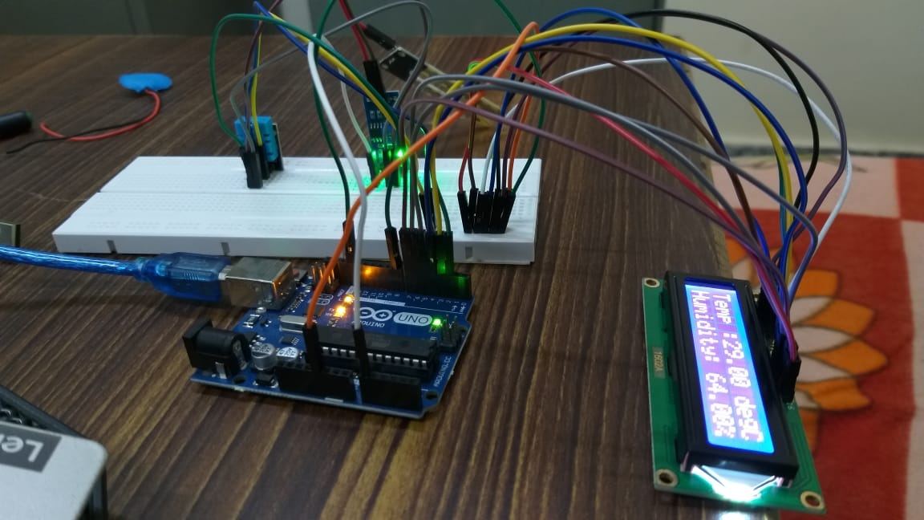
Components required
ARDUINO UNO.
TEMPERATURE AND HUMIDITY SENSOR(DHT11).
SOIL MOISTURE SENSOR.
BREADBOARD.
JUMPING WIRES (MALE TO MALE , MALE TO FEMALE ,AND FEMALE TO FEMALE ).
LCD.

Slide 5
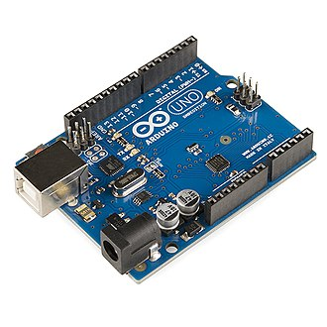
ARDUINO UNO
The Arduino Uno is an open-source microcontroller board based on the Microchip ATmega328P microcontroller and developed by Arduino.cc.
The board is equipped with sets of digital and analog input/output (I/O) pins that may be interfaced to various expansion boards (shields) and other circuits.
The board has 14 digital I/O pins (six capable of PWM output), 6 analog I/O pins, and is programmable with the Arduino IDE.

Slide 6
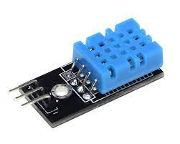
TEMPeRATURE AND HUMIDITY SENSOR (DHT11)
The digital temperature and humidity sensor DHT11 is a composite sensor that contains a calibrated digital signal output of temperature and humidity.
The sensor includes a resistive sense of wet component and an NTC temperature measurement device, and it is connected with a high-performance 8-bit microcontroller.
Only three pins are available for use: VCC, GND, and DATA.

Slide 7
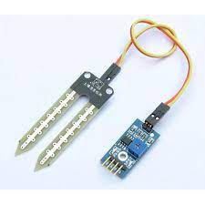
Soil moisture sensor
Soil moisture sensors typically refer to sensors that estimate volumetric water content.
By using some property of the soil, such as electrical resistance, dielectric constant, or interaction with neutrons, as a proxy for the moisture content.

Slide 8
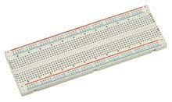
Breadboard
A breadboard, or protoboard, is a construction base for prototyping of electronics.
Compared to more permanent circuit connection methods.
Modern breadboards have high parasitic capacitance, relatively high resistance, and less reliable connections, which are subject to jostle and physical degradation.
Signaling is limited to about 10 MHz, and not everything works properly even well below that frequency.

Slide 9
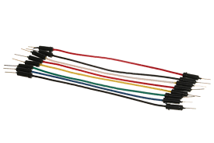
Jumping wires
A jump wire (also known as jumper, jumper wire, DuPont wire) is an electrical wire, or group of them in a cable, with a connector or pin at each end (or sometimes without them – simply "tinned"), which is normally used to interconnect the components of a breadboard or other prototype or test circuit, internally or with other equipment or components, without soldering.

Slide 10
PROJECT IMAGE

Slide 11
RESULT
THE DETECTING OUTPUT OF TEMPERTURE ,HUMIDITY AND MOISTURE IS SHOWN IN THE OUTPUT OF PROJECT SLIDE.
AND ALSO SHOWING WHICH CROPS ARE USEFUL AT THAT MOISTURE LEVEL.

Slide 12

METHODOLOGY OF RESEARCH
We used Arduino IDE to write the code, upload code in the Arduino uno.
We use MOISTURE AND DHT11 SENSOR to detect the moisture level of soil and the temperature and humidity of the environment.
And we have downloaded the DHT zip file in the Arduino IDE to detect the library of DHT in the IDE.
Arduino method we have used to detect this aim.

Slide 13
REFERENCES
Sanjukumar, R.V.Krishnaiah “ Advance Technique for Soil Moisture Content Based Automatic Motor Pumping for Agriculture Land Purpose” Volume 04, Article 09149; September 2013.
D. Ince, “Acoustic coupler,” in A Dictionary of the Internet. Oxford University Press, [online document], 2001. Available: Oxford Reference Online, http://www.oxfordreference.com [Accessed: May 24, 2007].
L. Bass, P. Clements, and R. Kazman, Software Architecture in Practice, 2nd ed. Reading, MA: Addison Wesley, 2003. [E-book] Available: Safari e-book
J. Geralds, “Sega Ends Production of Dreamcast,” vnunet.com, para. 2, Jan. 31, 2007. [Online]. Available: http://nli.vnunet.com/news/1116995. [Accessed Sept. 12, 2007].
C. Wilson-Clark, “Computers ranked as key literacy,” The Atlanta Journal Constitution, para. 3, March 29, 2007. [Online], Available: http://www.thewest.com.au. [Accessed Sept. 18, 2007].
https://www.youtube.com
WWW.PROJECTSOF8051.COM
WWW.ARDUINO.CC
WWW.CIRCUITSTODAY.COM

Slide 14
THANK YOU

